Slide 1
Stochastic multiple knapsack problem
Hossein Tohidi
Advisor: Dr. Osmal Ozaltin

Slide 2
Presentation Outlines
Introduction
Methodology
Numerical Example
Results and discussion
Conclusion
1
Notes:
Binary Knapsack Problem
Multiple Binary knapsack Problem
Stochastic Multiple Binary Knapsack Problem
Objectives
Solution Approach
Results
Conclusion

Slide 3
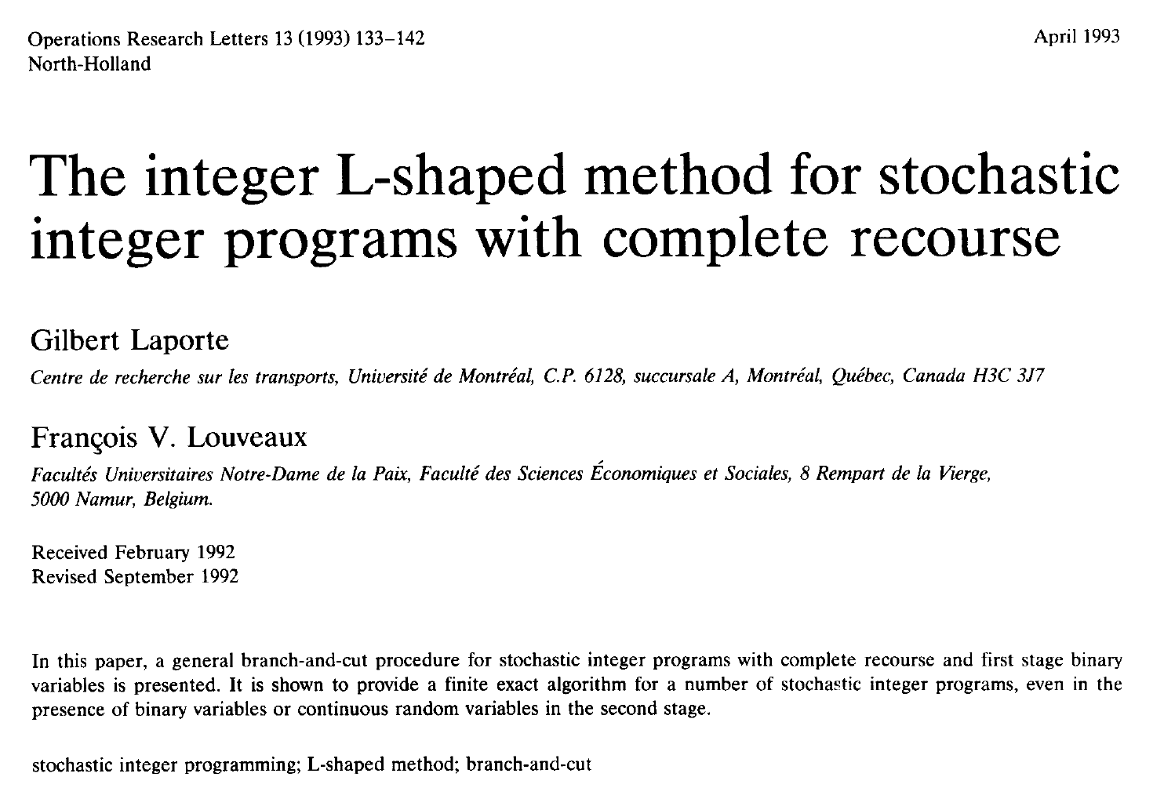
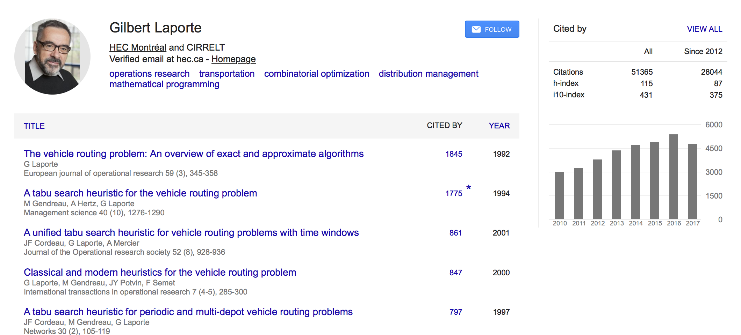
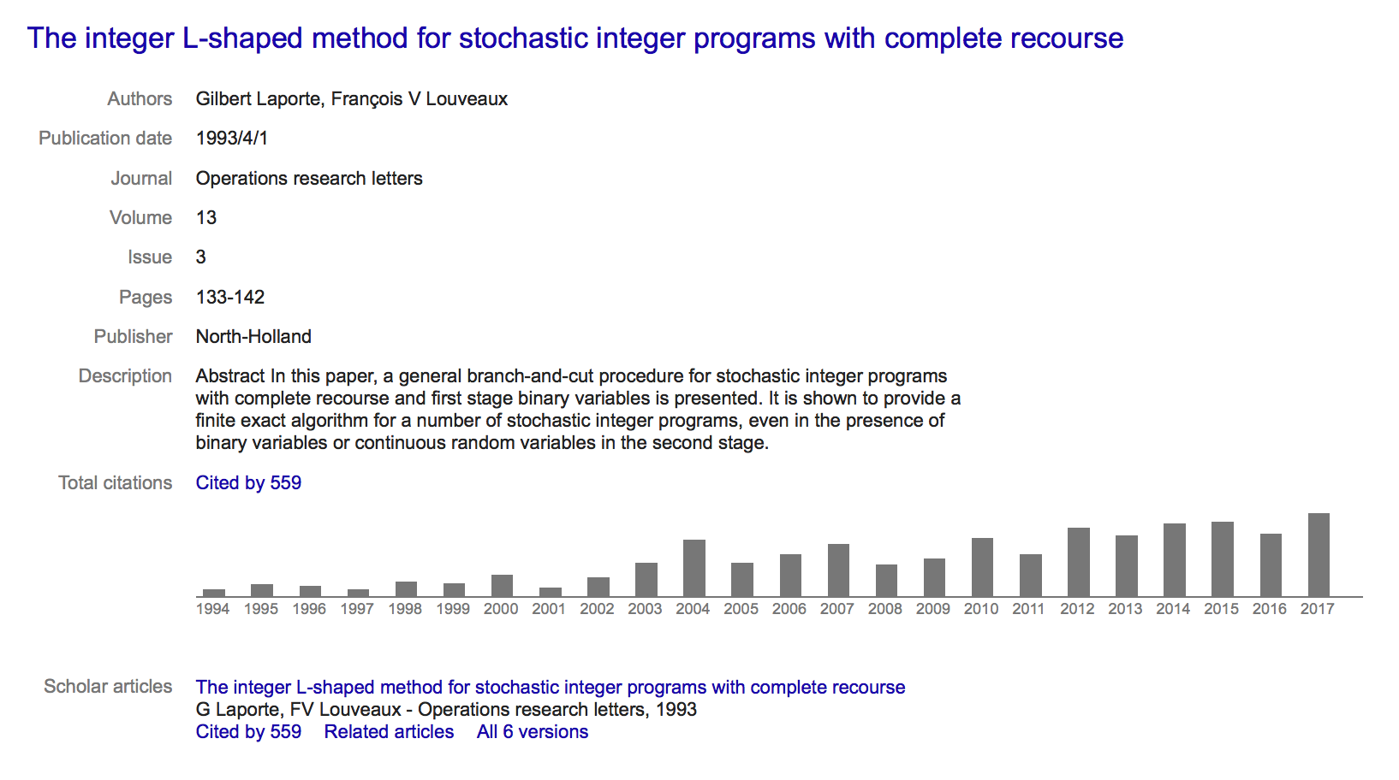
Introduction

Slide 4
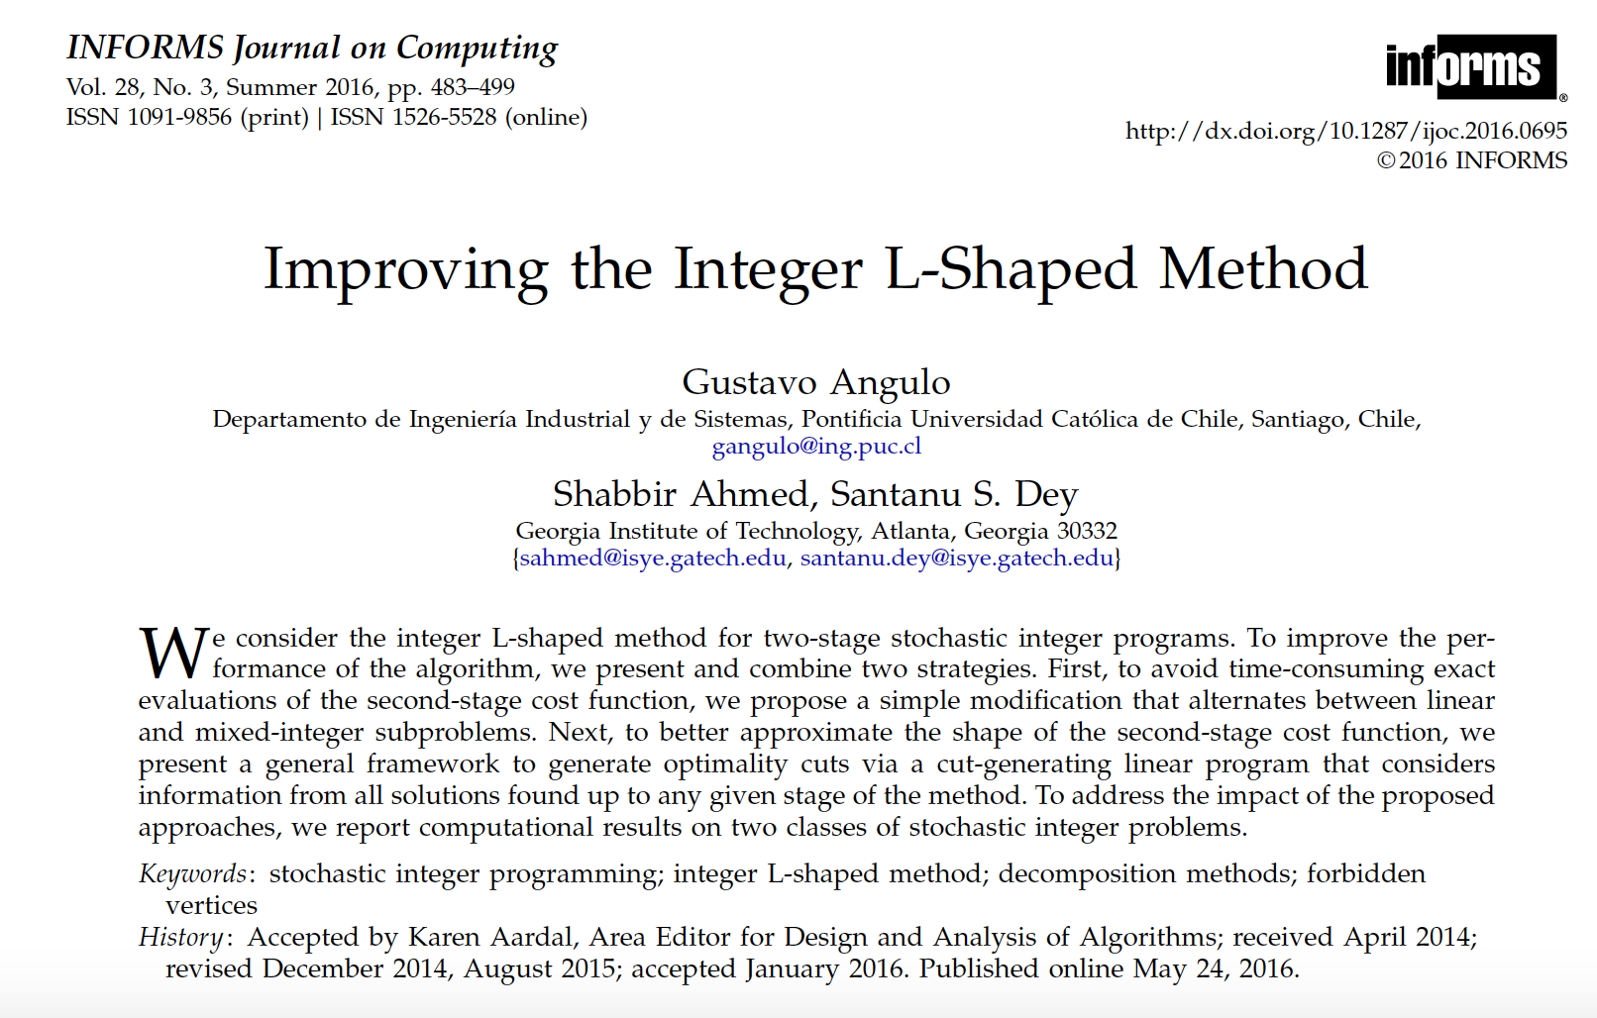
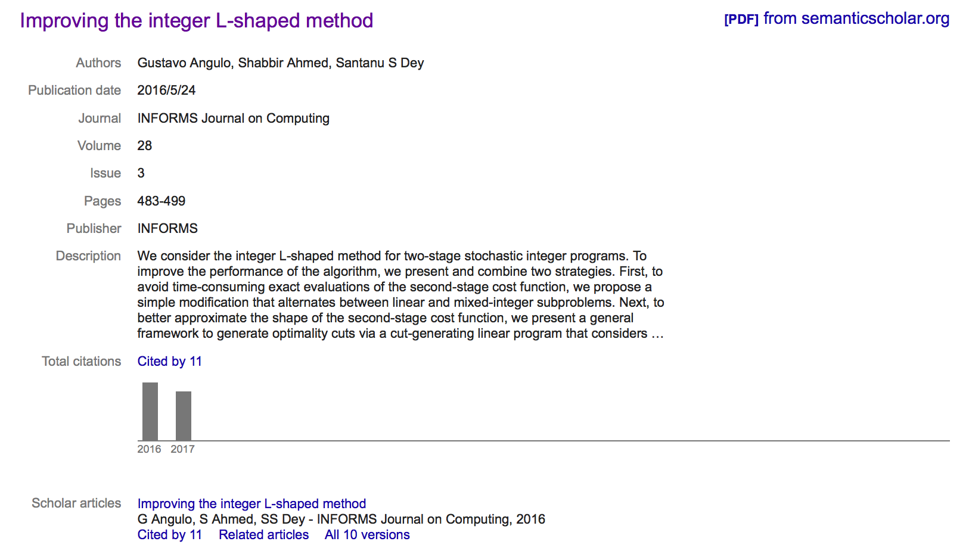
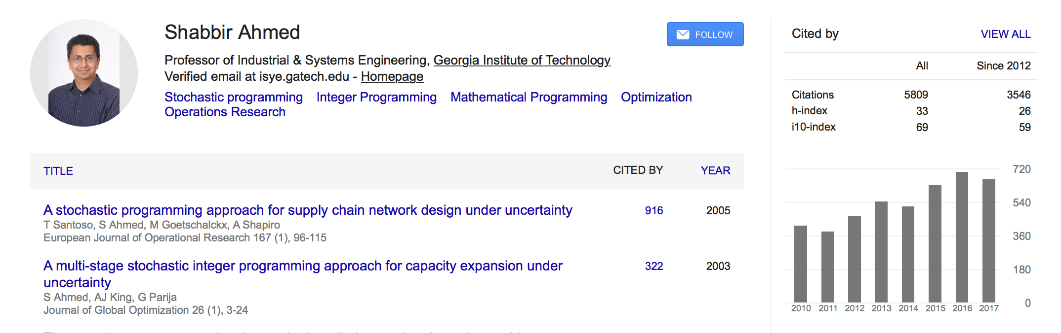
Introduction

Slide 5
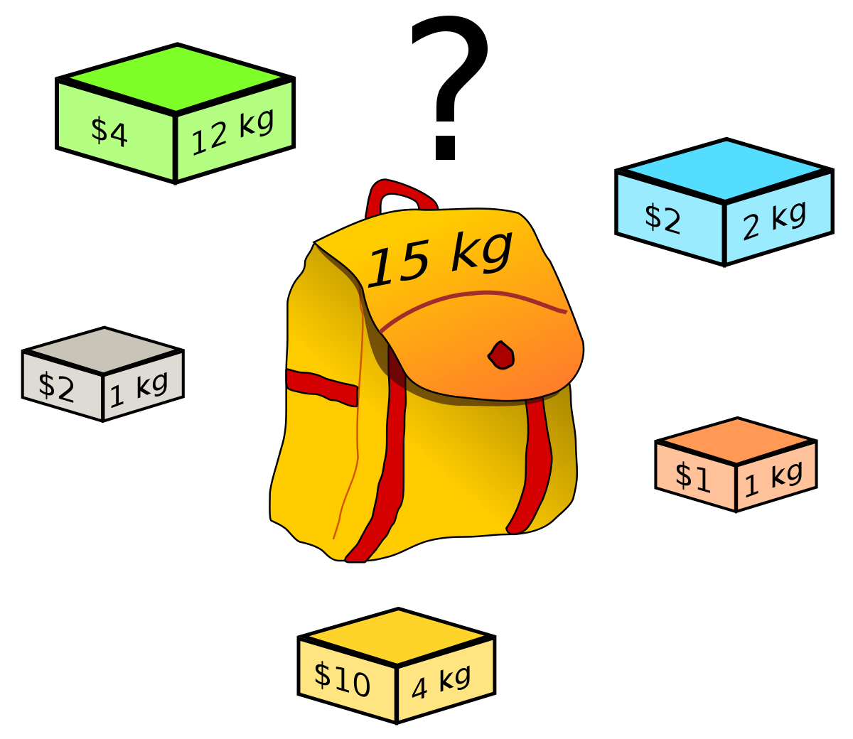
Binary Knapsack Problem
Given:
N items with their own weight and profit.
A knapsack with finite capacity.
Objective:
Find an item subset to maximize profit.
Constraint:
The capacity of knapsack should not be exceeded.

Slide 6
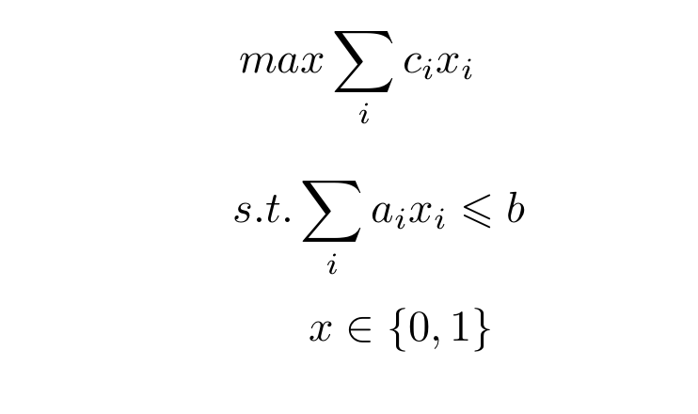
Binary Knapsack Problem

Slide 7
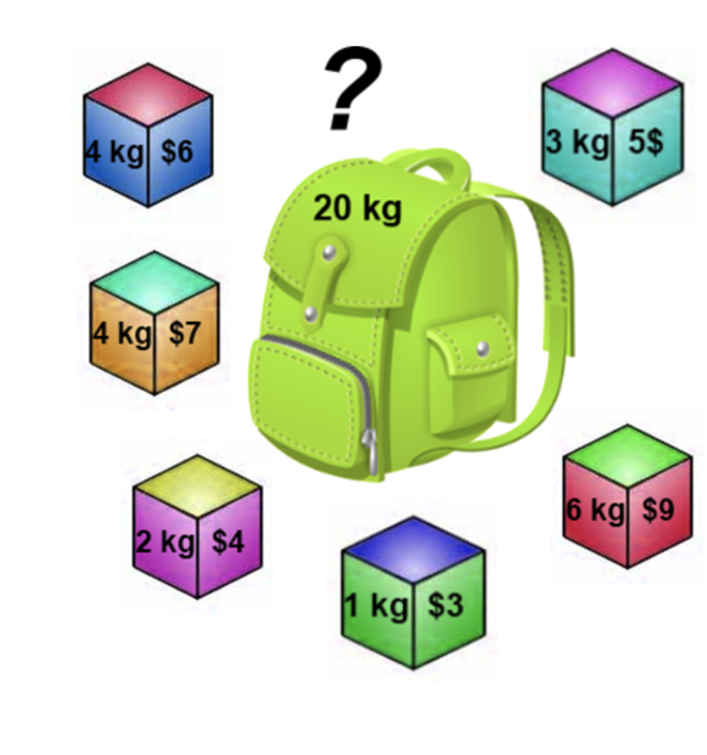
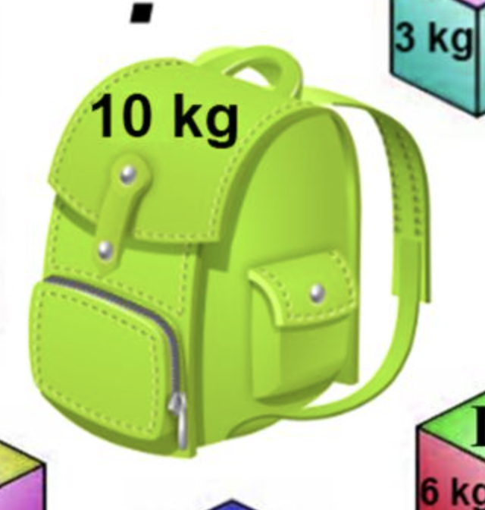
Multiple Binary Knapsack Problem
Given:
N items with their own weight and profit
M knapsacks with their own Capacity
Objective:
Find M item subsets to maximize profit.
Constraint:
The capacity of each knapsack should not be exceeded.

Slide 8
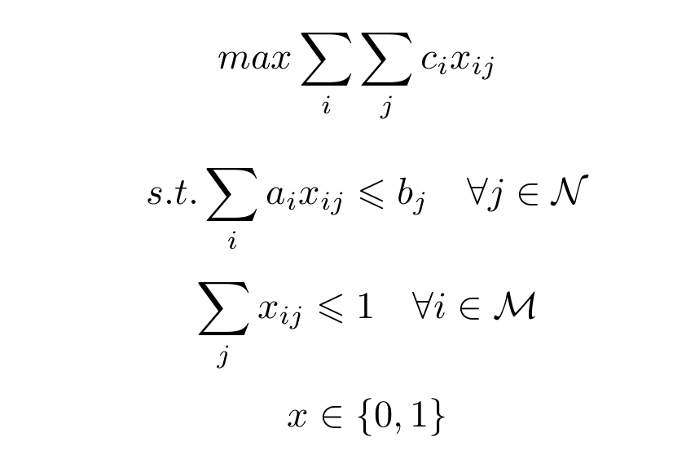
Multiple Knapsack Binary Problem

Slide 9
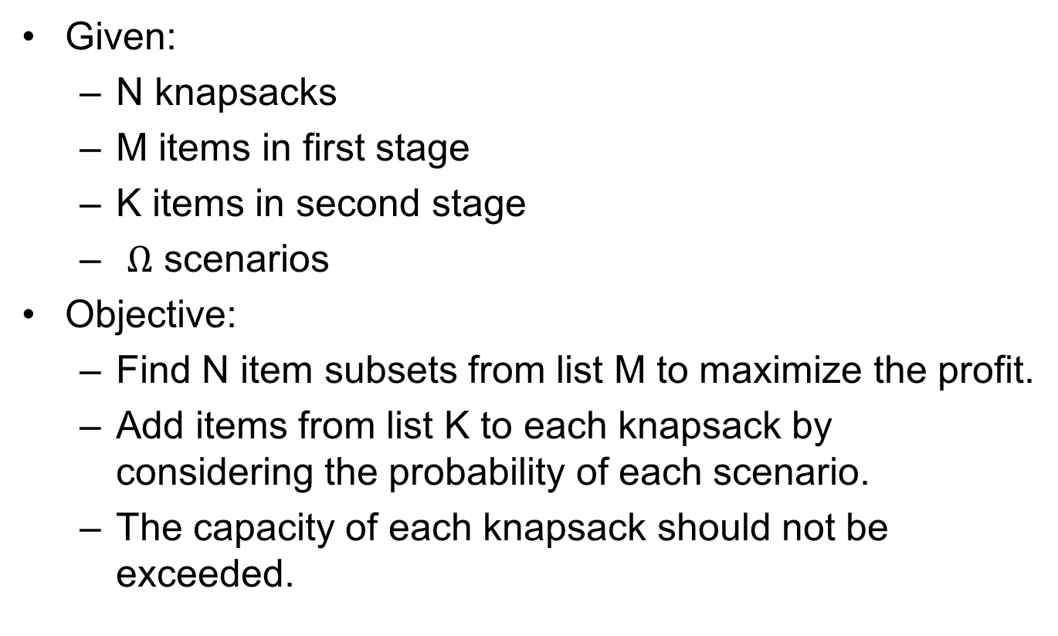
Stochastic Multiple Binary Knapsack Problem
Given:
N knapsacks
M items in first stage
K items in second stage
$Ω$ scenarios
Objective:
Find N item subsets from list M to maximize the profit.
Add items from list K to each knapsack by considering the probability of each scenario.
The capacity of each knapsack should not be exceeded.

Slide 10
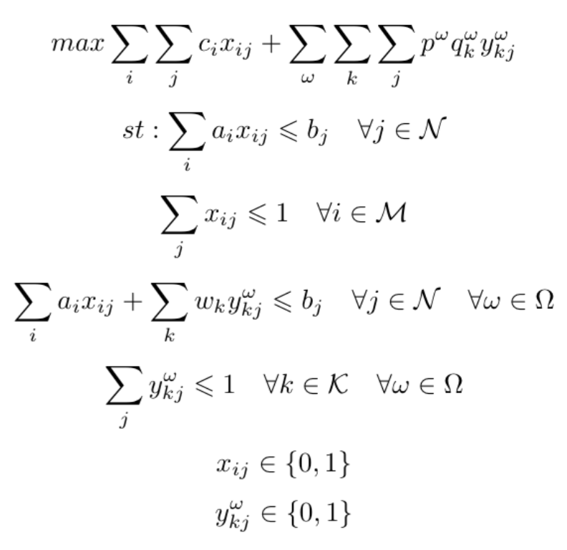
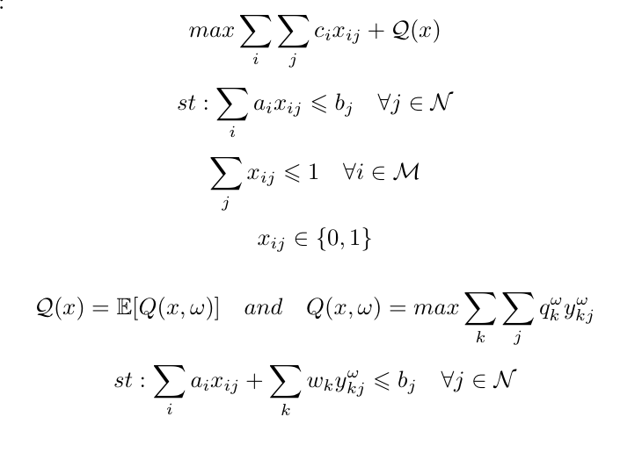

Extensive Form
Two-stage form
First stage constraints
Second stage constraints

Slide 11
Objective
Find exact solution for stochastic multiple binary knapsack problem.

Slide 12

Methodology
Integer L-shaped Method

Slide 13
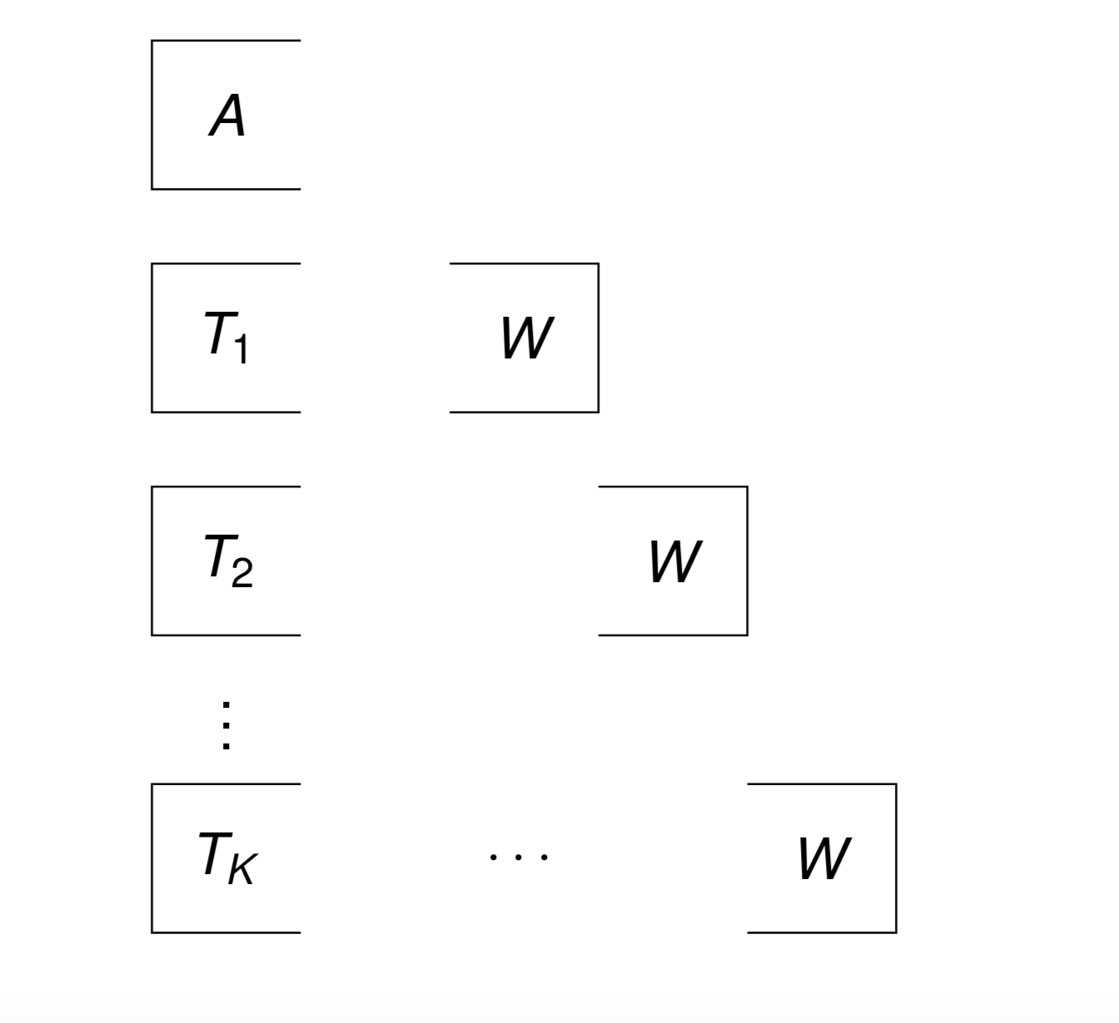
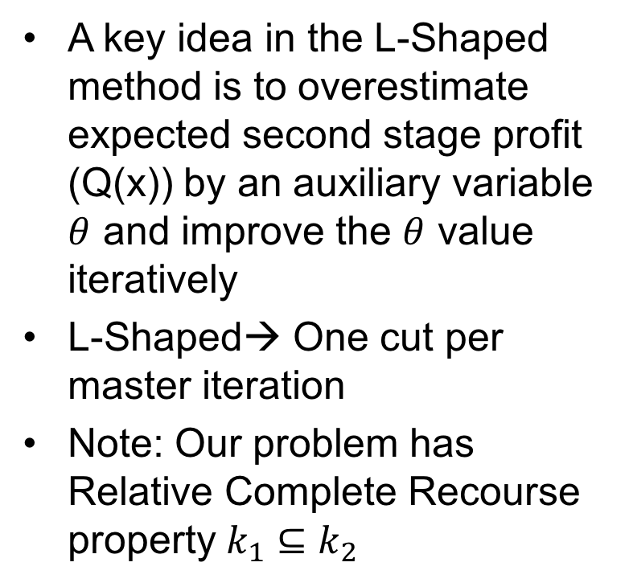

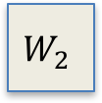

L-shaped Algorithm
A key idea in the L-Shaped method is to overestimate expected second stage profit (Q(x)) by an auxiliary variable $θ$ and improve the $θ$ value iteratively
L-Shaped→ One cut per master iteration
Note: Our problem has Relative Complete Recourse property $k_{1}⊆k_{2}$
T
T
$$W_{1}$$
T
$$W_{2}$$
T
$$W_{k}$$

Slide 14
Integer L-shaped
Why not extensive form?
When the second stage decision variables are not Integer:
Using Benders Decomposition
Using dual information to generate L-shaped optimality cuts.
In the multiple binary knapsack problem, all variables are binary. So the integer L-shaped algorithm is implemented

Slide 15
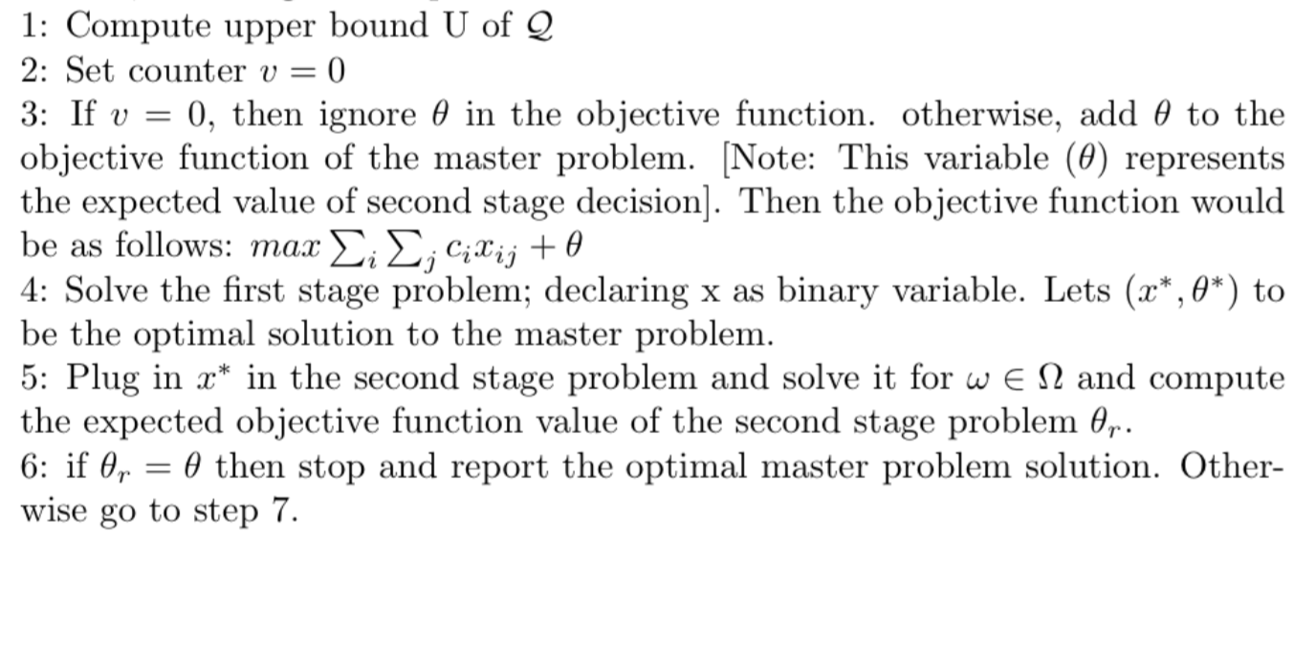
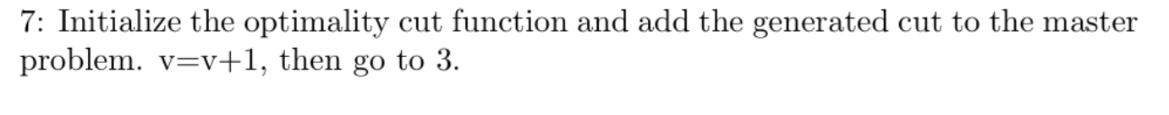
Integer L-shaped Algorithm:

Slide 16
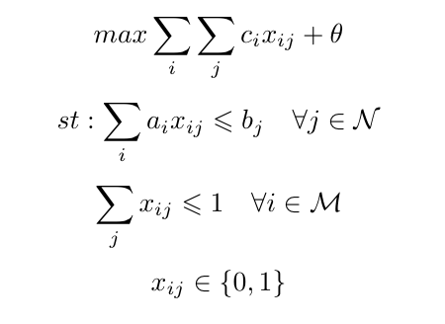
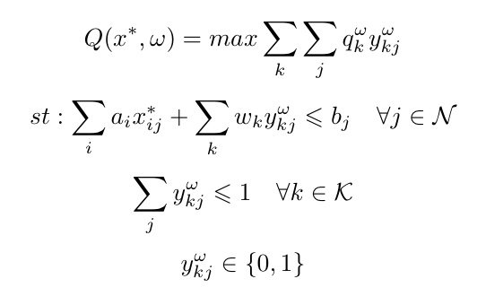
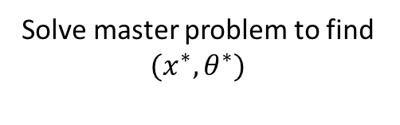


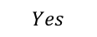

Flow Chart
Solve master problem to find ${(x}^{∗},θ^{∗})$
solve Scenario 1
solve Scenario 2
solve Scenario 3
Find ${𝔼(Q}^{∗})$
$${𝔼(Q}^{∗})≤θ$$
$$No$$
End
$$Yes$$
Add Optimality Cut

Slide 17
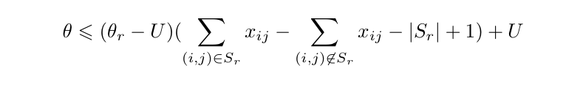
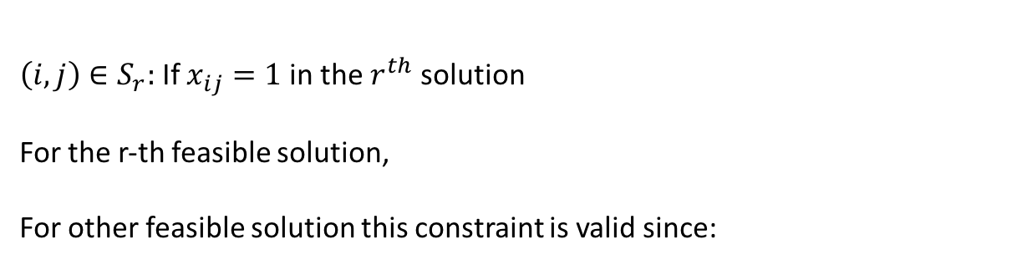
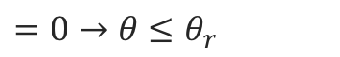

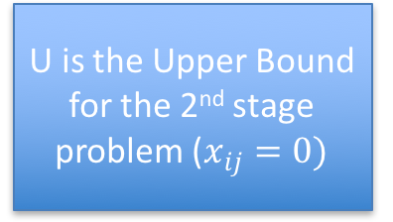
Optimality Cut
Introduced by Laporte & Louveaux [1993]*
U is the Upper Bound for the 2nd stage problem ($x_{ij}=0)$
${\left(i,j\right)∈S}_{r}:$ If $x_{ij}=1$in the $r^{th}$ solution
For the r-th feasible solution,
For other feasible solution this constraint is valid since:
$$=0→θ≤θ_{r}$$
$$≥0→θ≤U$$
* G. Laporte,F. V. Louveaux,"The integer L-shaped method for stochastic integer programs with complete recourse", Operations Research Letters 13 (1993) 133-142

Slide 18


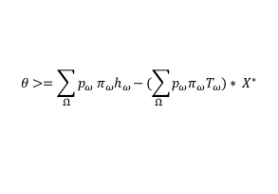
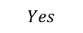
Flow Chart:
LP_relaxation
LP_relaxation
LP_relaxation
solve Scenario 1
solve Scenario 2
solve Scenario 3
Find Dual variable of the second stage
Find ${𝔼(Q}^{∗})$
$$Yes$$
$$θ>=\sum_{Ω}{p_{ω }π_{ω}h_{ω}−}(\sum_{Ω }{p_{ω}π_{ω}T_{ω})∗ X^{∗}}$$
Add a Benders Cut
$$No$$
End
$${𝔼(Q}^{∗})≤θ$$
$$No$$
Turn off Benders Cuts
$$Yes$$
Add Integer Optimality Cut

Slide 19
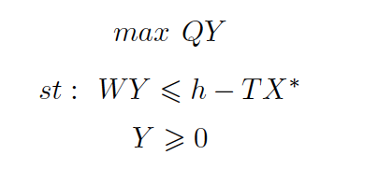
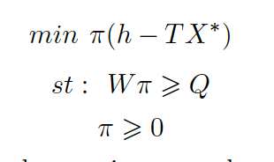

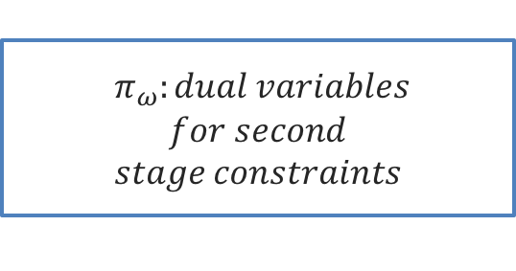
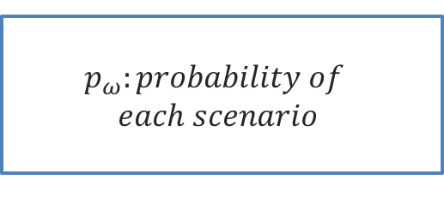
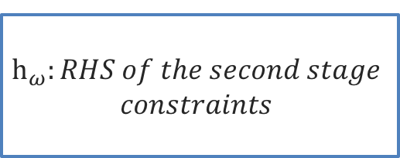
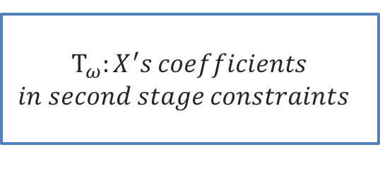
Benders Optimality cut
$$θ≤\sum_{Ω}{p_{ω }π_{ω}h_{ω}−}(\sum_{Ω }{p_{ω}π_{ω}T_{ω})∗ X}$$
$$p_{ω}:probability of$$
$$each scenario$$
$π_{ω}:dual variables$
$$for second$$
$$stage constraints$$
$$h_{ω}:RHS of the second stage$$
$$constraints$$
$T_{ω}:X^{′}s coefficients$
$$in second stage constraints$$

Slide 20
Implementation
Python 2.7.13 64bits
Gurobi 7.5.1

Slide 21
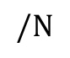
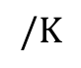
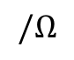
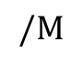
Numerical examples:
To investigate the efficacy of the algorithm, 13 different numerical examples have been randomly generated. But how to ensure the result is correct? (Formulate the problem in the extensive form!)
Case No.
$$/M$$
$$/N$$
$$/K$$
$$/Ω$$
Number of scenarios
Number of items in the 1st stage
Number of knapsack
Number of items in the 2nd stage

Slide 22
Results:
Case No. | Extensive form | L-shaped with only Integer Cut * |  | L-shaped with Both integer cut and Benders cut*
 | Obj. Value | Obj. Value | % Gap | Obj. Value | % Gap
5/2/4/3 | 550.33 | 550.33 | 0 | 550.33 | 0
10/2/4/3 | 720.33 | 797.33 | 10.68 | 720.33 | 0
20/2/4/3 | 1012.66 | 3851 | 280.28 | 1012.66 | 0
50/2/4/3 | 1211.17 | 8646.33 | 613.88 | 1211.17 | 0
10/5/4/3 | 1153.66 | 3665 | 217.68 | 1153.66 | 0
20/10/4/3 | 1675.66 | 7929 | 373.18 | 1675.66 | 0
100/20/4/3 | 5279.66 | 142630.66 | 2601.51 | 5280.04 | 0.0071
5/2/10/3 | 866.66 | 866.66 | 0 | 866.66 | 0
5/2/20/3 | 955.33 | 955.33 | 0 | 955.33 | 0
5/2/30/3 | 1250.66 | 1250.66 | 0 | 1250.66 | 0
5/2/4/10 | 637 | 637 | 0 | 637 | 0
5/2/4/20 | 1024 | 1024 | 0 | 1024 | 0
5/2/4/100 | 1024 | 1024 | 0 | 1024 | 0
*Running time limit is 600 second.

Slide 23
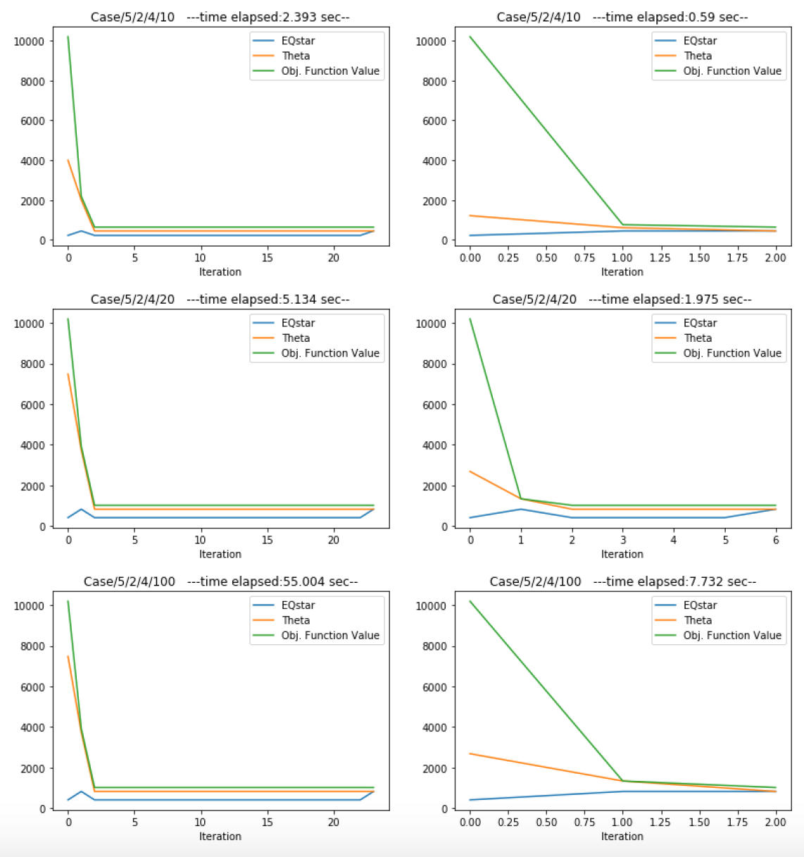
Discussion

Slide 24
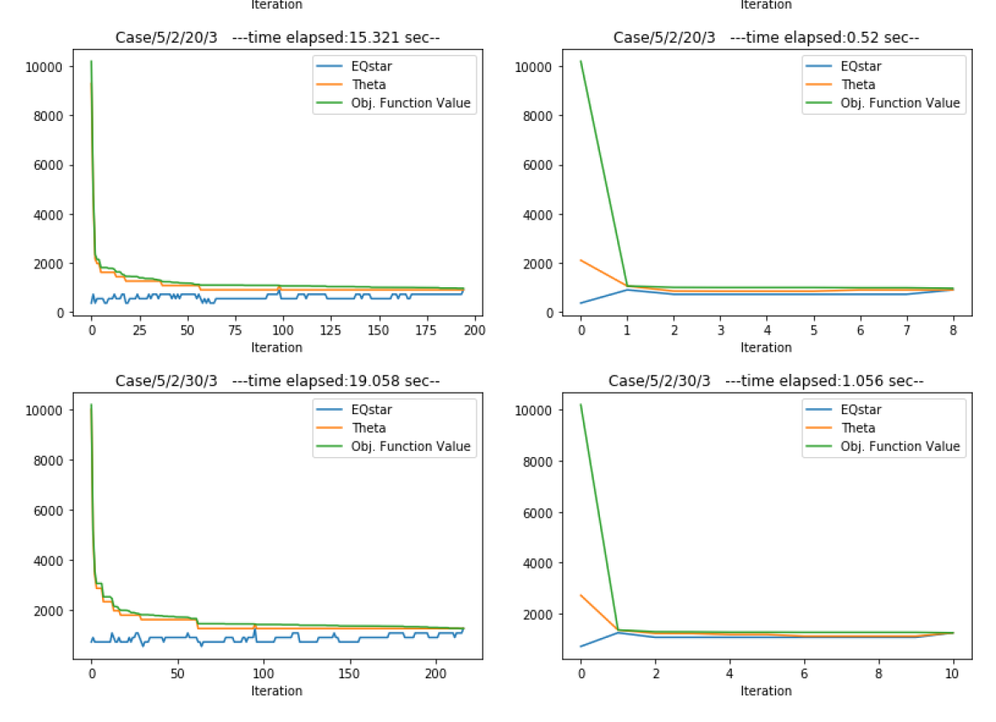
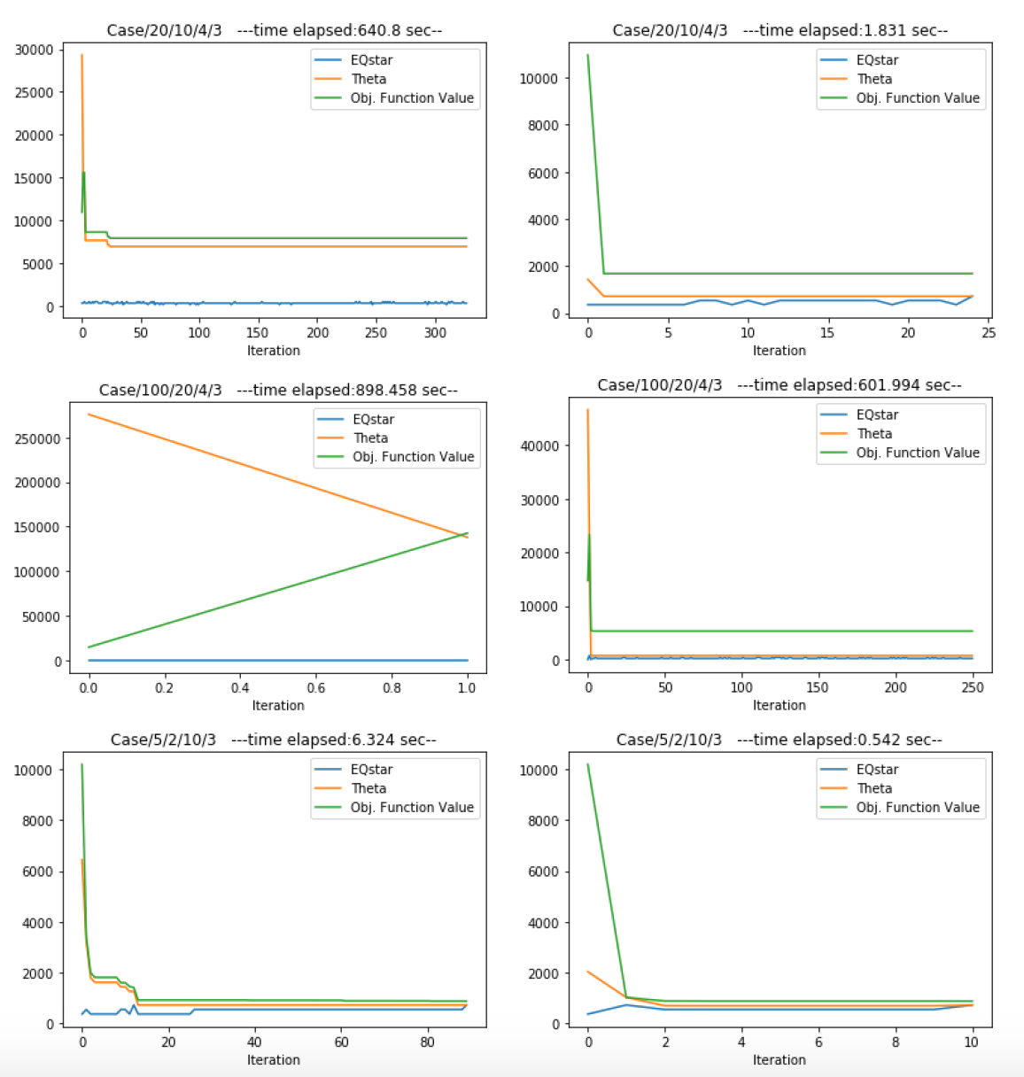
Discussion(continue)
GAP=% 373.18

Slide 25
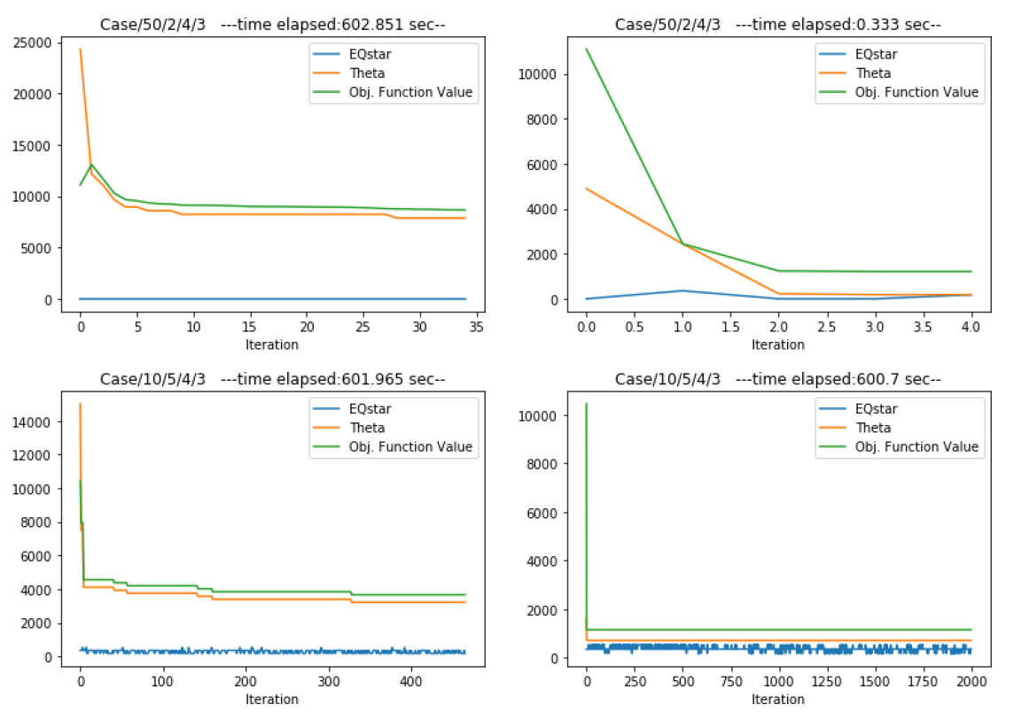
Discussion(continue)

Slide 26
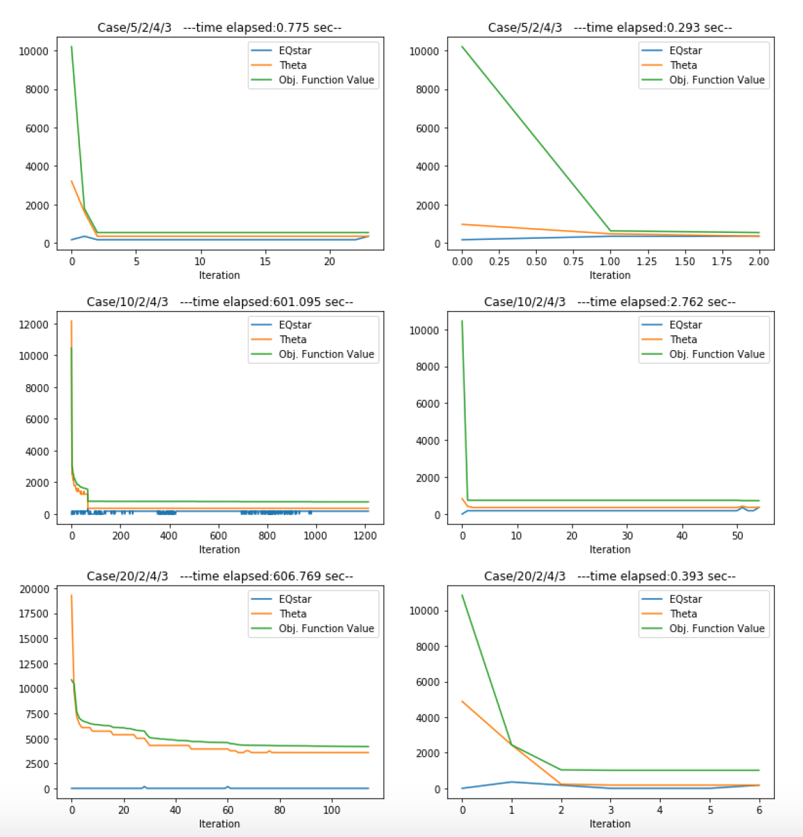
Discussion(continue)

Slide 27
Conclusion
In this study, a two-stage multiple binary knapsack problem has been considered and two different algorithms developed to solve this problem iteratively.
Increase in number of scenario, may lead to a very complicated problem, which solvers are not able to handle it effectively.
Mixing two cuts (Benders Cut and Integer L-shaped Cut) was so effective in solving large scale problems.

Slide 28
References
1- S. Ahmed, S. S. Dey, "Improving the integer L-shaped method", Informs journal on Computing, Vol 28, No. 3, 2016, pp. 483-499
2- G. Laporte,F. V. Louveaux,"The integer L-shaped method for stochastic integer programs with complete recourse",Operations Research Letters 13 (1993) 133-142
3- G. Mavrotas, D. Diakoulaki, A. Kourentzis, "Selection among ranked projects under segmentation, policy and logical constraints", Eur J Oper Res, 187(1) (2008) 177–192.
4- DC. Vanderster, NJ Dimopoulos, R Parra-Hernandez, "Resource allocation on computational grids using a utility model and the knapsack problem", Future Gener Comput Syst, 25(1) (2009) 35–50.
5- FS PeetaS Salman, D Gunnec, "Pre-disaster investment decisions for strengthening a highway network", Comput Oper Res, 37(10) (2010) 1708–1719.
6- J Lorie, L.J Savage, "Three problems in capital rationing", Journal of Business, 28 (1955) 229-239
7- A.S Manne, H.M Markowitz, "On the solution of discrete programming problems", Econometrica, 25 (1957) 84-110.
8- P.C Gilmore, R.E Gomory, "The theory and computation of knapsack functions", Operations Research, 14 (1966) 1045-1075.
9-J Edmonds, "Minimum partition of a matroid into independent subsets", Journal of Research of the National Bureau of Standards, 69B (1965) 67-72.
10-C.C Petersen, "A capital budgeting heuristic algorithm using exchange operations", AIIE Transactions, 6 (1974) 143-150.
11-R.E Echols, L Cooper, "Solution of integer linear programming problems with direct searchJournal of the Association for Computational Machinery", 15 (1968) 75-84.
12-B Gavish, H Pirkul, "Efficient algorithms for solving multiconstraint zero–one knapsack problems to optimality", Mathematical Programming, 31 (1985) 78-105.13- P Chu, J Beasley, "A genetic algorithm for the multidimensional knapsack problemJournal of Heuristics", 4 (1998) 63-86.

Slide 29


Thank you!
Hossein

